Slide 1
Software Basics
Introduction to Software Development

Slide 2
Software development training

Slide 3
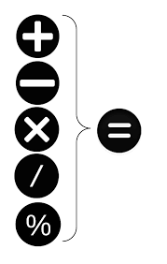
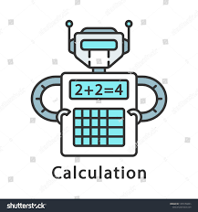

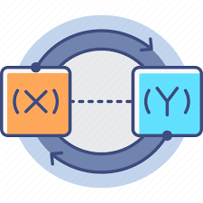

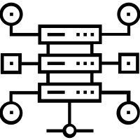
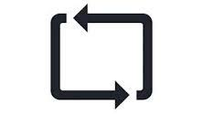
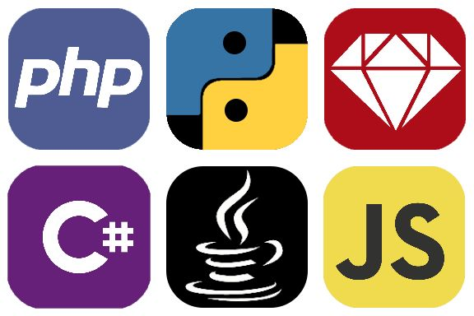
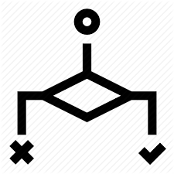
The developer toolbox
Variables
(External Input)
Calculations
You and your logic
The IDE
The IDE
Loops / Repeat
Conditions / Branching
Data Structures
The Programming Language

Slide 4
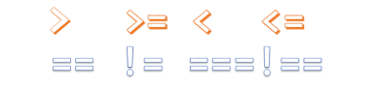
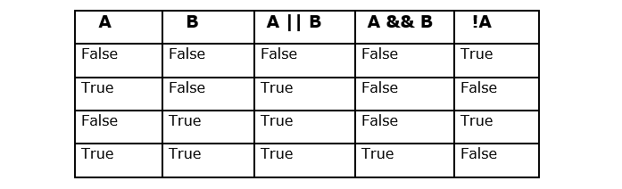
Operators Recap
Assignment operator (=)
Numerical operators (+, -, *, /, %)
Comparison (==, ===)
Comparison (>, >=, >==, <, <=, <==, !=, !==)
Logical (&&, ||, !)
Unary (+, -, ++, --) [Postfix and Prefix]

Slide 5
Conditional statements
Conditional Statements (if, switch)
Ternary operator (? :)

Slide 6
Looping statements
while ( condition ) { }
  let i = 1; while ( i < 10 ) { i++; }
for ( init ; condition ; increment ) { }
  for ( let i = 1; i < 10; i++ )

Slide 7
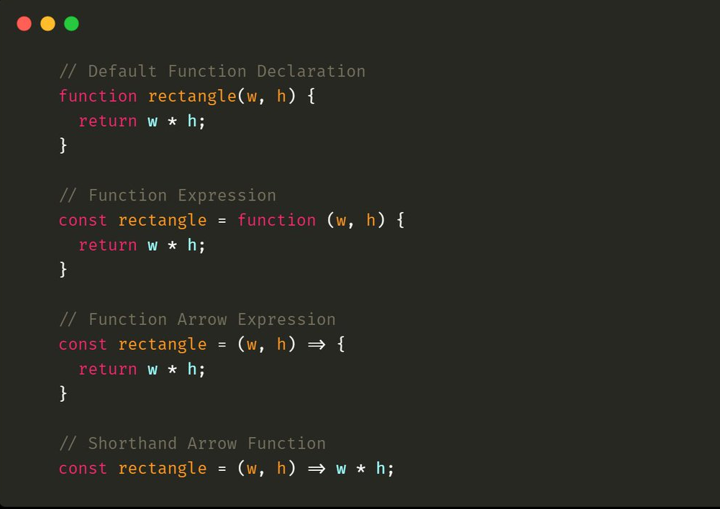
Functions
Functions are constructs which help organize code into logical segments.
As a general rule, any piece of code which is repeated more than a couple of times should be converted into a function.
In programming parlance this is called:
DRY – Do not repeat yourself
WOAOA – Write once and only once
This helps reduce the length of the program and errors since lesser code = lesser errors

Slide 8
Assignments
Check out w3c.org for specifications of HTML and CSS
Check out https://developer.mozilla.org/en-US/docs/Web/JavaScript for specifications of JavaScript
Solve first level of JavaScript course on https://www.codeacademy.com
Try HTML course on https://www.codeacademy.com

Slide 9
How does software work? (Languages)
There are broadly two types of languages from the aspect of variable declarations
  Statically typed
  Dynamically typed
In a statically typed language – I need to define a variable and its data type before I can use it in my program e.g., C, C++, C#, Java, TypeScript
In a dynamically typed language – I do not need to define a variable or its data type before using it – often data types are hidden in such languages e.g., Python, PHP, Visual Basic, JavaScript

Slide 10
All in his (atfs service

